Slide 1
What is Economics?
A Social Science
Economic Models: Corrrelation
Economic Policy Tool:
Personal
Business
Government

Slide 2
Economics
Thomas Malthus, 1800
Population Growth vs. Food Growth
Technology, Efficiency, & Productivity
Pessimistic View v. Optimistic View
Limited Resources
Scarcity, Allocation of Resources
Diamond-Water Paradox
Microeconomics and Macroeconomics
Classical: Adam Smith, 1776:
Invisible Hand, Specialization
Keynesian: James Maynard Keynes, 1930s:
In the long run, everyone’s dead

Slide 3

Choice: The Heart of Economics.
Economic Decision.
She must choose.
And her choice affects others.
Wants vs. Needs
What economic decision that you made today?

Slide 4
Economic Issues
Self-interest v. Social Interest
Globalization
Information Age
Climate Change
Social Security Time Bomb

Slide 5
The Five Principles Common Ground – Economic Way of Thinking
Incentives
Trade-Offs
Opportunity Costs
Marginal Benefits – Marginal Costs
Trade Creates Value

Slide 6

1. Incentives
Choices are necessary
because
resources are scarce.
People responds to Incentives.
Positive and negative.
Direct and indirect.

Slide 7

Incentives and Performance
People usually respond to incentives, exploiting opportunities to make themselves better off.
In the United States, restaurant customers have the option of adding a tip to the restaurant bill. In much of Europe a tip is added automatically.
Where would you expect waiters to be more attentive?

Slide 8
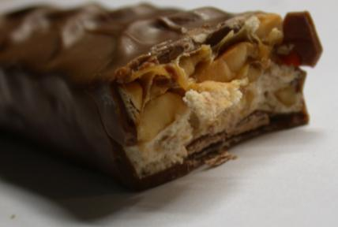
2. Trade-offs
Trade-off: comparison of the costs and the benefits of doing something.
Each bite of the candy bar has costs and benefits.
Beijing 2008 Olympics: Clean Air or Economic Prosperity?
What kind of trade-off that you did lately?

Slide 9

3. Opportunity Cost
Opportunity cost:
what you must give up in order to get something.
Mark Zuckerberg understood the concept of opportunity cost—and dropped out of Harvard.
What is your opportunity cost of attending classes?

Slide 10
Got a Penny?
Sixty years ago, a penny was equivalent to 30 seconds worth of work—it was worth saving a penny if doing so took less than 30 seconds.
Today, wages have risen along with overall prices, a penny is now equivalent to just over 2 seconds of work—and so it’s not worth the opportunity cost of the time it takes to worry about a penny more or less.
The rising opportunity cost of time in terms of money has turned a penny from a useful coin into a nuisance.
In April 2012, The Central Bank of Canada stopped printing (not the circulation) new penny coins.

Slide 11
Describe the opportunity costs
Attend college instead of taking a job
foregone earning of potential job, valuable job experience;
on the other hand, there are benefit of having a college degree,
with the possibility of higher earning in the future.
2. Watch a movie instead of studying for exam
3. Ride the bus instead of driving your car
4. More people choose to get graduate degrees when the job market is poor.
5. There are more parks in suburban than in urban areas.
6. Fewer students enroll in classes that meet before 10:00 am.

Slide 12
4. Marginal Thinking: Benefits-Costs
“How much” is a decision at the margin.
Weighing the extra benefits
against the extra costs.
If I eat one cookie each night before sleeping, how many extra pounds would I gain in a year?
If I study one more hour each night, I would increase 0.5 point in my GPA.
What marginal thinking that you have done lately?

Slide 13
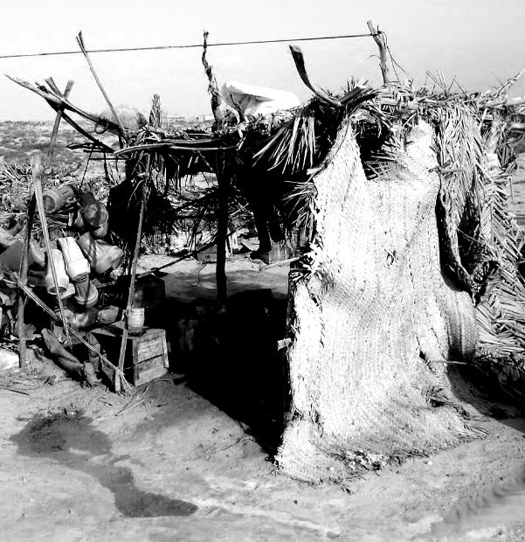
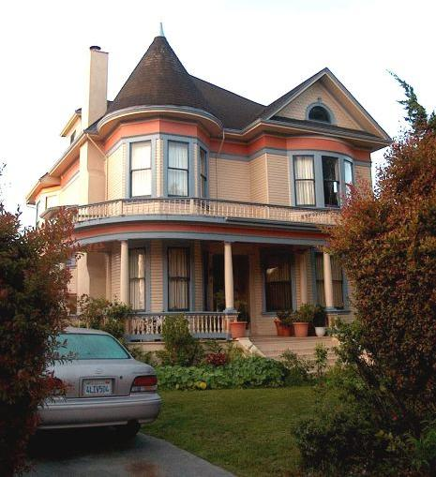
5. Gains from Trade
Trade allows us all to consume more than we otherwise could.
Comparative Advantage, based on Specialization

Slide 14

Adam Smith on Specialization
Specialization: the situation in which each person specializes in the task that he or she is good at performing.

Slide 15

Equity vs. Efficiency
Scarcity of Space
Personal needs v. Social needs
Equity: a condition in which everyone gets his or her “fair share.”
(There are many definitions of equity.)
Equity and efficiency are often at odds.
Equity trumps efficiency in disabled parking space offerings.

Slide 16
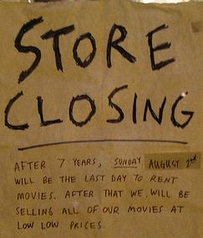
Economic Recessions: Business Cycle
During recessions, a drop in business spending leads to:
Less income,
less spending…
…and further drops in business spending, layoffs, and rising unemployment.

Slide 17
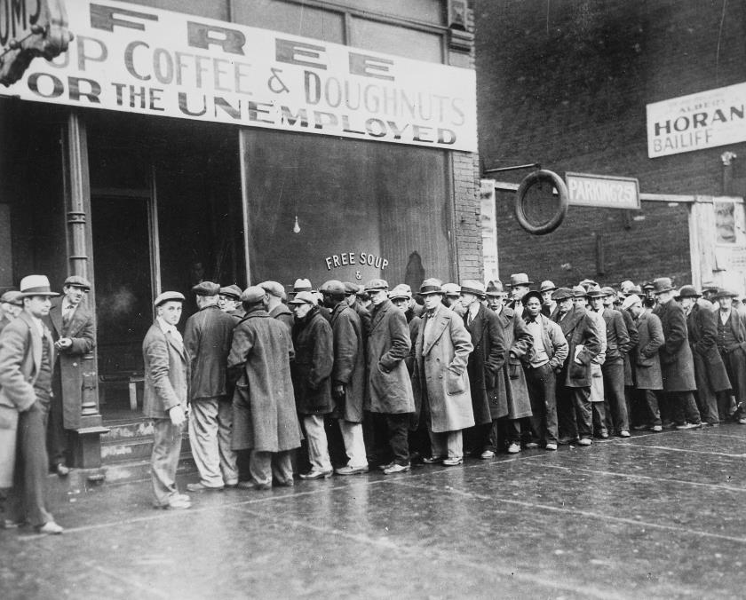

Government Policy
The U.S. government funded the WPA and provided almost 8 million jobs between 1935 and 1943.
In response to the Housing Crisis, American Recovery Act 2009

Slide 18
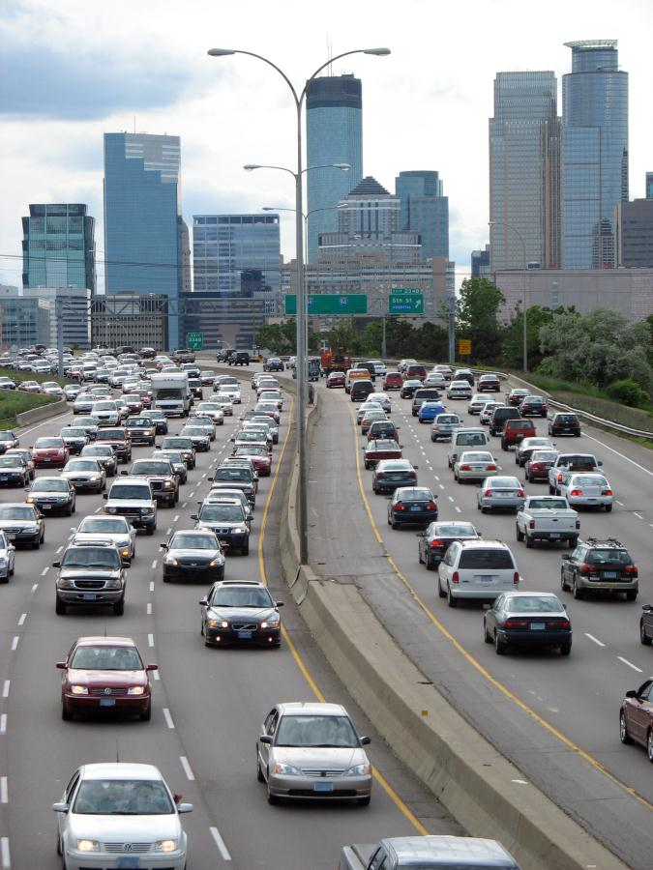
Work in pair. Write down your answer in a piece of paper, put both of your names.
The US Government drives up miles-per-gallon requirements: auto-emission and fuel economy standards will require up to 35.5 mpg by 2016, in order to limit the amount of CO2 emission. (source USA Today, May 18, 2009).
Discuss the situation in terms of the foundations of Economics: Incentives, Trade-offs, Opportunity Cost, Marginal Thinking, Trade; then answer the following questions:
What are two benefits of the new mpg requirements? Are these benefits in someone’s self-interest or in the social interest?
What are two costs associated with this new mpg requirements?
Provide another government policy that influence behavior, then give two benefits and two costs of this policy.

Slide 19
Exercise: multiple-choice
1) Which of the following describes the reason why scarcity exists?
a. Governments make bad economic decisions
b. The gap between the rich and the poor is wide
c. Wants exceed the resources available to satisfy them
d. There is too much unemployment
2) Economics is the social science that studies ……..
The best way of eliminating scarcity
The choices made to cope with scarcity
How money is created and used
The inevitable conflict between self-interest and social interest
3) A rational choice is ….
The best thing you must forgo to get something
What you are willing to forgo to get something
Made by comparing marginal benefit and marginal cost
The best for society

Slide 20
Exercise
4) Which of the following best illustrates your marginal benefit from studying?
The knowledge you gain from studying two hours a night for a month
The best things forgone by studying two hours a night for a month
What you are willing to give up to study for one additional hour
What you must give up to be able to study for one additional hour
5) Economic models are used to …
Clarify normative disagreements
Avoid the need to study the real questions
Replicate all the features of the real world
Focus on those features of reality assumed relevant for understanding a cause and effect relationship

